Slide 1

Privacy shield –The Data Anonymizer

Slide 2

Data Anonymizer
Overview : This document contains 5 sections, section-1 is about introduction to the project, section-2 and 3 contains the design and development of project, section-4 contains the user manual and section-5 contains future work

Slide 3

1. Introduction

Slide 4

1.1. Context
The digital world of now is composed of personalized data services and there is a huge demand for data, especially for personal data
Large volumes of data can now be employed quite efficiently to gain new insights on a certain phenomenon, and data mining algorithms can give a lot of information about persons, events or entities
The purposes for which one requires meaningful personal data are very diversified, for example, research or public health policy purposes, to develop new services and products, to enhance the efficiency and effectiveness of new drugs, or even to simply condition people’s behaviour, when they make a purchase on an online store
Attacker
You

Slide 5
1.2. Motivation
In recent years, escalation of technology led to an increase in the capability to record and store personal data about consumers and individuals
To mitigate these issues, some de-identification methodologies have recently been proposed that, in some well controlled circumstances, allow for the re-use of personal data in privacypreserving ways
We will present a web tool that provides a way to easily anonymize data

Slide 6

Anonymization
Anonymity, means simply that a person is not identifiable
The anonymization process is intended to irreversibly remove the association between an individual and some information that can identify this person
Personal data is anonymized to protect the privacy of subjects when storing or disclosing data
Data Anonymizer
Your data
*Hides*

Slide 7
1.3. Scope of Project
The main objective of this project is to create web application which make it easy for a user to anonymize the data
It means the user can upload the dataset and can choose configuration or create a new configuration with in the web interface for de-identification, after that the de-identified or anonymised data can be downloaded
The important task of this project was to create an interface for the user such that a new configuration can be developed on the dataset

Slide 8
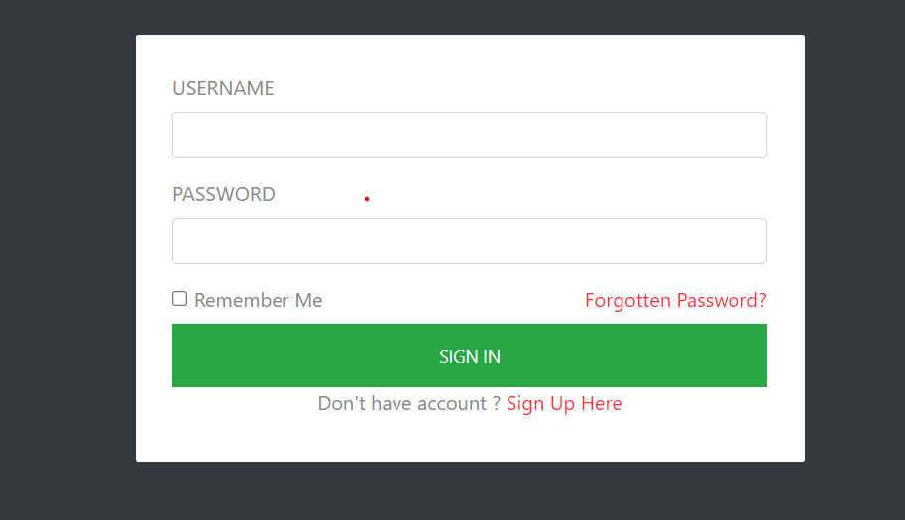

Slide 9

Design and Development

Slide 10
2. Architecture
In order to give the web application some structure, a layered architecture was created, grouping the different components in sections
This layered separation is often used on web platforms, on this particular architecture is separated in three layers
Each of these layers is responsible for a particular and unique processing, they communicate with each other through different frame works and languages, so, aggregating all those tiers in a single framework simplifies hugely this interconnection process

Slide 11
Presentation Layer
This layer contains the user oriented functionalities, they are responsible for managing user interaction with the system, and generally consists of components that provide a common bridge to the business layer core
Presentation tier components allow users to interact with the application

Slide 12
Business Tier
This layer implements the core functionality of the system and encapsulates the relevant business logic
It generally consists of elements that execute rules and separates them from the user interface and data access

Slide 13

Data Tier
The data tier provides access to the databases and storage devices used by a three-tier applications. It is responsible for retrieving data and transforming into a suitable format for the rest of the application. Essentially, this layer stores and retrieves information to the business tier for processing and eventually to the presentation tier. On adapting the ARX API there was no need to use a database, because saving the files locally was sufficient enough to perform the anonymization.

Slide 14
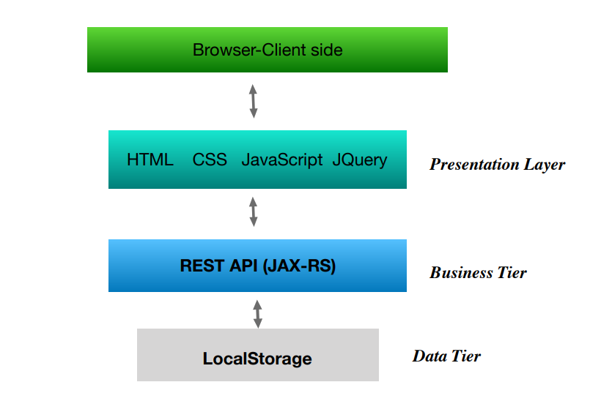

Slide 15
Technologies

Slide 16
Client-side
In the application front-end, we used five technologies: HyperText Markup Language (HTML), Cascading Style Sheets (CSS), JavaScript, Jquery, and Asynchronous JavaScript and XML (AJAX). The web page presented on the user’s browser was built on HTML, created from scratch, exhibiting a simple but intuitive interface that guides the user through a configuration process that sometimes could be a complex task. In order to make the HTML more attractive, we applied CSS, giving a better visual presentation to the interface.
Another technology used in order to send and receive data from the server, is called JavaScript Object Notation (JSON), and is useful for parsing JavaScript objects into text. This is needed when the client wants to exchange data with the server because this data has to be in text format. JSON converts JavaScript objects into text, and vice-versa, the data is saved as pairs of keys/values and they are kept as an array of strings. This technology was used in all the AJAX requests created, parsing the data sent to the server, or making the reverse process for the received array of data.

Slide 17
Server-side
JERSEY :Jersey RESTful Web Services framework is open source, production quality framework for developing RESTful Web Services in Java that provides support for JAX-RS APIs
REST: A web application without resources don’t serve for much, they are usually something that can be stored on a computer, e.g., an electronic document, a dataset or the result of executing an algorithm
Tomcat: To deploy the services and resources, apache tomcat is being used as server

Slide 18
ARX API
The ARX open source tool allows the user to change structured sensitive personal data, using Statical Disclosure Control , into data that can be shared securely
ARX API has been chosen for anonymization process because of its simplicity and organised code, with a good documentation, plus a deductive online javadoc with all packages and classes included in the API
The ARXConfiguration defines a group of settings that are sent to the ARXAnonymizer, this configuration allows multiple parameters, offering the user an opportunity to create suitable de-identified datasets

Slide 19
3.4. Project Folder Structure and Dependencies
The data that is uploaded to the server or data anonymizer will reside in a directory named Anonymization_resources of root folder
Inside the directory it again contains folders named data sources, configurations, hierarchies for their respective files
Also the output folder contains the recent anonymized file

Slide 20
4. Interface/User Manual
Data Sources: By clicking the data sources card the user will be redirected to the data sources page
Configurations: By clicking the configurations card from the index page, the user will be redirected towards configurations page

Slide 21
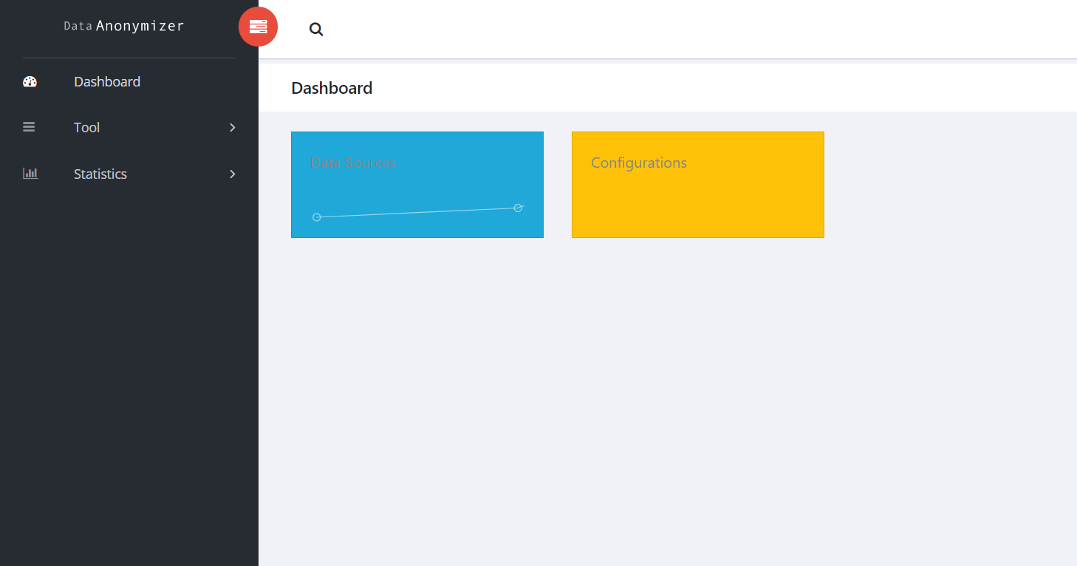

Slide 22
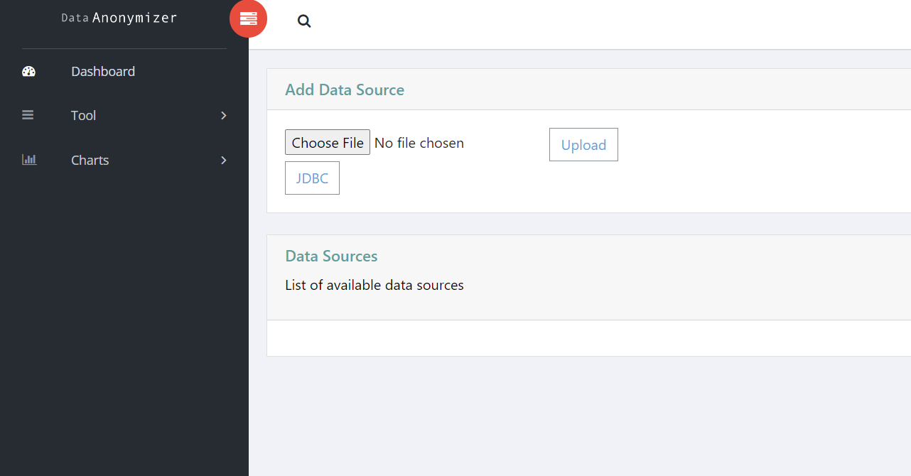

Slide 23
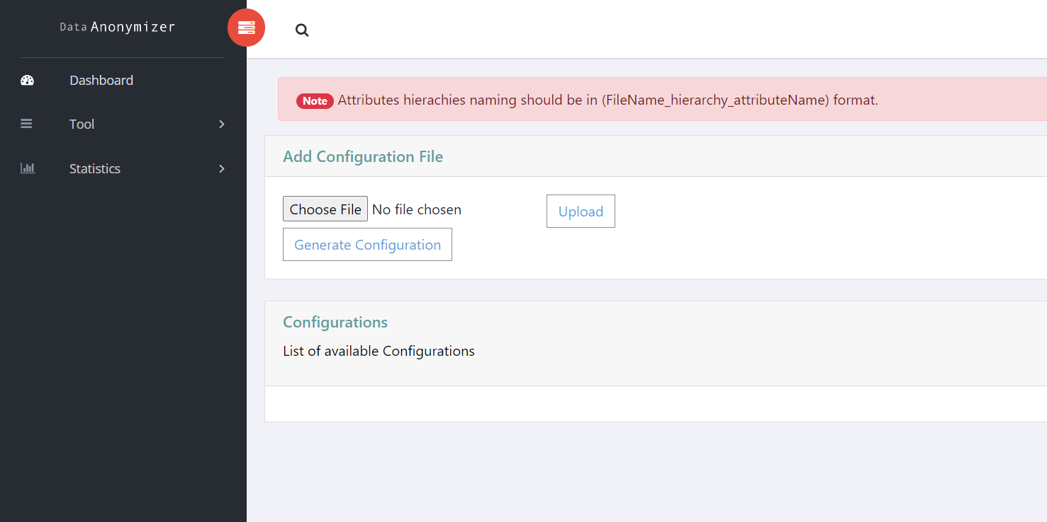

Slide 24
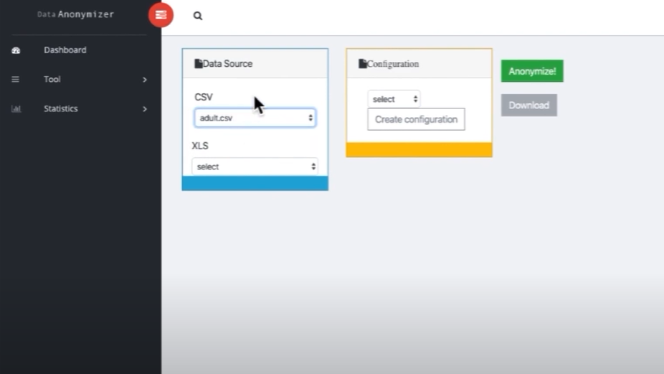

Slide 25
4.3. Privacy Model
Typically most of the anonymization algorithms are based on Generalization and Suppression of QID attributes
They are

Slide 26
k-Anonymity
This algorithm requires that each QID tuple appear in at least k-1 records, this will ensure at minimal, that released data processed with k-anonymity will be difficult to re-identify
The QIDs contains information that is more likely to find over the dataset, so this type of attribute is more vulnerable to re-identification
k-anonymity uses generalization and suppression methods

Slide 27
l-diversity
This algorithm requires a high entropy on the distribution of SAs for each QID
The main idea behind l-diversity, is the well balancing dispersion of SAs between all the groups included on the datasets
Vulnerability- Similarity attacks, that happens because it considers the diversity of SAs in the group, but it is not concerned with the semantic proximity of the values

Slide 28
t-closeness
Due to the fact that previous privacy models had some vulnerabilities, a new one emerged, the t-closeness algorithm
It requires that the distribution of a SA in any equivalence class must be similar to the attributes distribution in the overall dataset, this way, the chances of learning individual’s information are lower
In order to introduce and manage gaps between values of SAs, tcloseness uses the Earth Mover Distance metric , receiving a precise distance between the two distributions

Slide 29
Hierarchies
Defining the intervals is important in the configuration process, all the solutions below use this mechanism, but sometimes is not clear what their function is, neither the right way to configure them
Hierarchies are normally used for categorical attributes, to increase the utility of anonymized datasets, "categorisation" is often combined with tuple suppression, i.e., data records inconsistent with privacy criteria are automatically removed from the dataset
Data and generalization hierarchies can be imported from many different types, providing compatibility with a wide range of data processing tools

Slide 30

Hierarchies
In this tool the hierarchies can be supplied by the user in the form of ‘CSV’ files, which each file contains the column headers specifying the level fo the hierarchy and rows contain intervals or generalised attributes

Slide 31
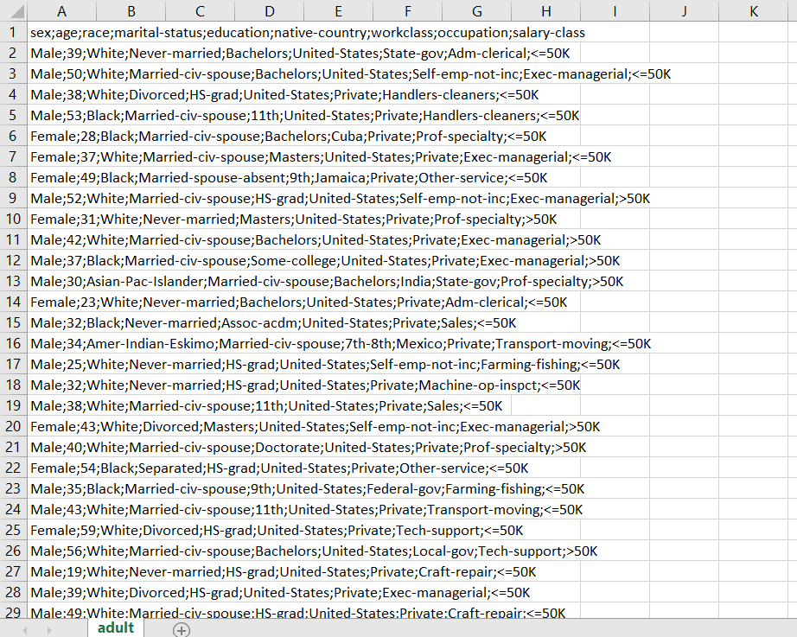

Slide 32
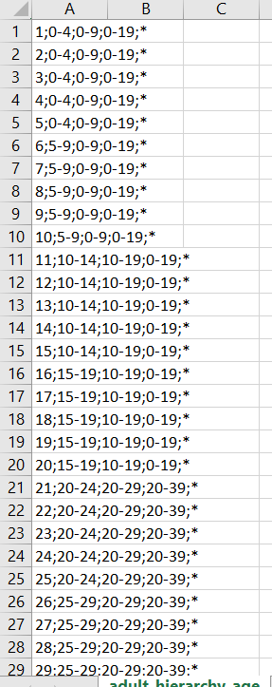
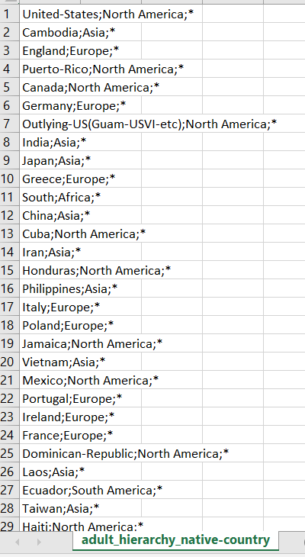
Adult hierarchy age
Adult hierarchy native country

Slide 33
Attack scenarios
Identity Re-identification:
Attack Scenario: Malicious actors attempt to re-identify individuals in the anonymized dataset to discover sensitive information.
Prevention: Techniques like k-anonymity, l-diversity, and t-closeness introduce generalization and suppression methods, making it challenging to identify specific individuals.
Homogeneity Attacks:
Attack Scenario: Attackers exploit patterns in the data to reveal that a particular attribute is the same for a group of individuals.
Prevention: k-Anonymity helps protect against homogeneity attacks by ensuring that each quasi-identifier tuple appears in at least k-1 records, reducing the risk of revealing identical sensitive information.

Slide 34
4.4. Anonymize
When the user has both Data source and configuration selected or in place, then by clicking the anonymize button the anonymization process can be initiated
After the anonymization the user can download the anonymized data by clicking the ‘Download’ button which is below on the ‘anonymize’ button
After the anonymization process the Data Source file will be automatically deleted from the server in order for the system to maintain privacy

Slide 35
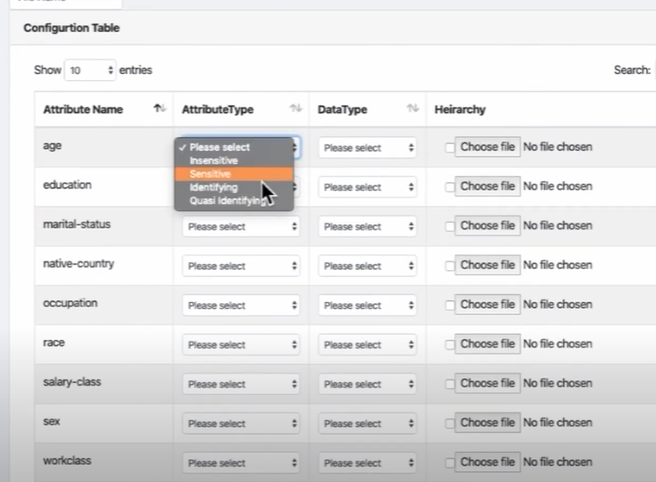

Slide 36
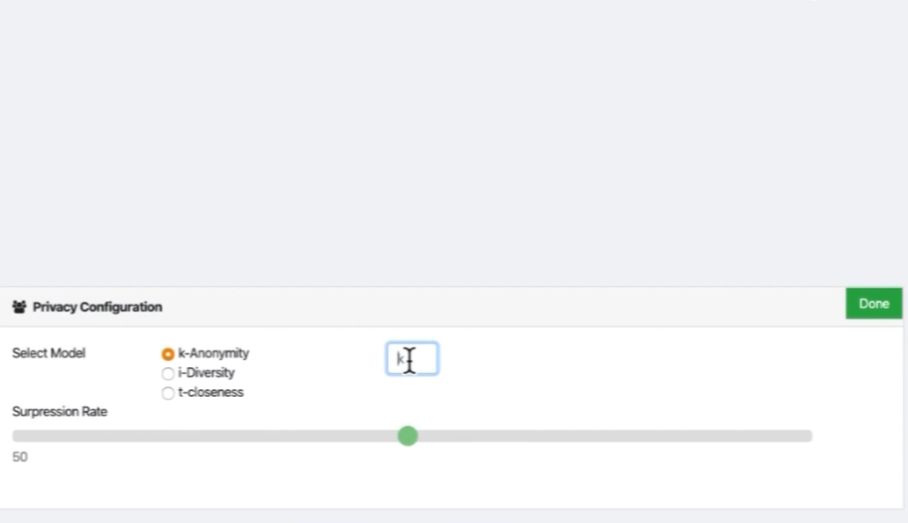

Slide 37
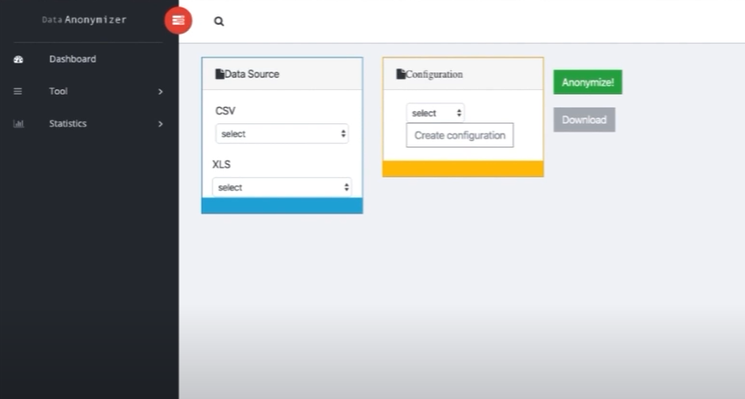

Slide 38
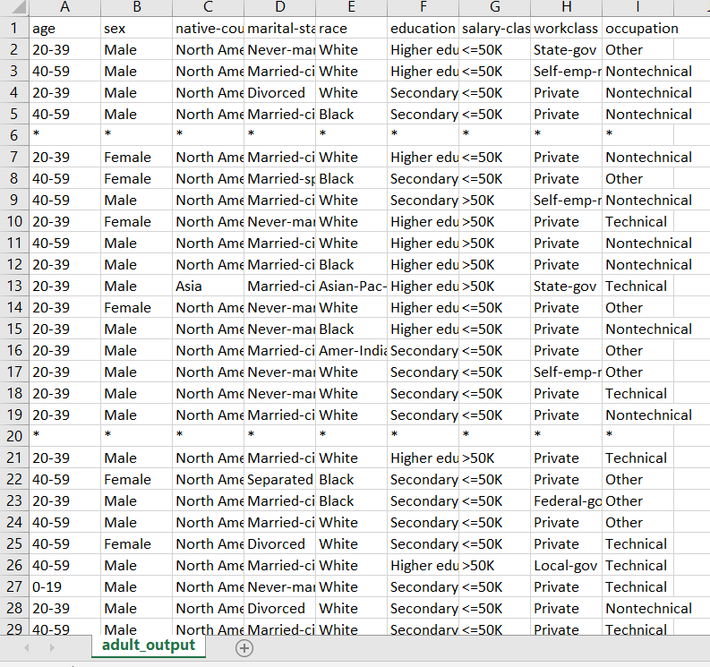

Slide 39
5. Future work
Improving Interface design- The design of this version is composed of single wizard which contains all the features
Database storage- In this version the files uploaded by the user are being stored in a local storage due to ARX API in the server which is a kind of limitation
Input and output views- When the file has been uploaded by the user, there is no option in the present system to view the input
Hierarchy Creation- Similar to creating the configuration there can be an interface for each attribute to specify the intervals or levels or generalisations
ARX - Open Source Data Anonymization Software
A Web Anonymizer Platform for Datasets with Personal Information

